Slide 1
IDEA PROPOSAL
Bhumikaa B.
Bachelors of Engineering,
Artificial Intelligence & Machine Learning Branch At Cambridge Institute of Technology

Slide 2
WorldMart
A Global Store
PRIMARY OBJECTIVES: A comprehensive “unified global seller/buyer platform”.

Slide 3
MERITS:
*BUSSINESS MERITS:
Expanded market reach for seller’s across the geographic boundaries.(Approximately 190+ countries)
Market place can offer/serve to the needs of approximately 80.1 billion population across the geographies under 1-platform.
AI driven marketing for both seller and buyer.

Slide 4
*SOCIAL MERITS:
Provide cultural exchange.
Establish worthy trust between buyer and the seller across geographical territories.
Balancing global supply and demand chain by:
1.Effectively showcase surplus products against deficit requirement.
2.Expose consumers to seasonal and regional best products .

Slide 5







UNIQUE SELLING POINT
OBJECTIVE:
USP matrix | 1 | Multiple
1
multiple
WorldMart | A Global Store

Slide 6
WorldMart is the one stop platform which provides all the above solutions.
Problem statements:
Solutions:
Regional business regulations.
Language barriers.
World wide product visibility.
Quality versus cost factors approach.
Global supply and demand management marketing.
Exposing buyer seller for the global market.
cultural training
Local expertise
Legal support
Regular updates
Hedging
Local pricing
Strategic alliances market analysis
local partnerships
market research

Slide 7
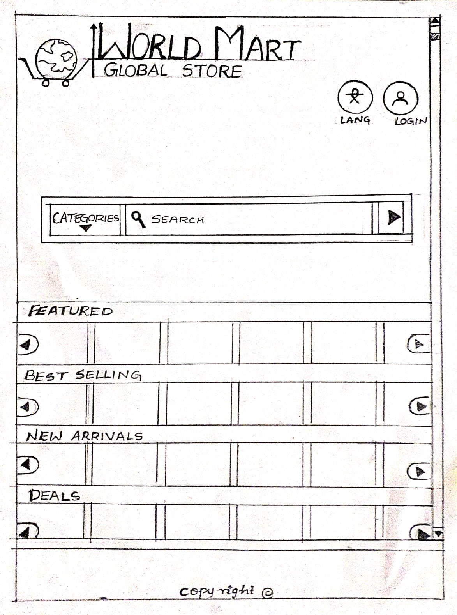
PROTOTYPE

Slide 8
Thank You
WorldMart | A Global Store

